Slide 1
Rethinking Reporting
Using Fresh Grade as Tool to Communicate Student Learning

Slide 2
Communication is Key
Education is shared between the home and the school.
Good communication is important as we work together to support student learning.
Research tells us that:
Placing a number or letter grade on everything a student does can negatively impact motivation and learning.
Giving fewer marks and more feedback can lead to improved student achievement.
Notes:
Add picture

Slide 3
This type of reporting will include…
Learning goals
Student voice
Evidence of learning (photographs, videos, audio, anecdotal comments)
Teacher comments
Goal setting

Slide 4
What is Formative Assessment?
Includes:
Sharing goals and criteria with students
Giving descriptive feedback while they are working towards those goals
Helping students improve through self and peer assessment
Notes:
Add chart

Slide 5
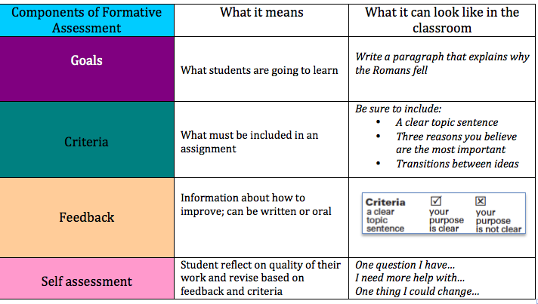
Formative Assessment in the Classroom
Notes:
Add picture

Slide 6
We need to be rethinking reporting

Slide 7
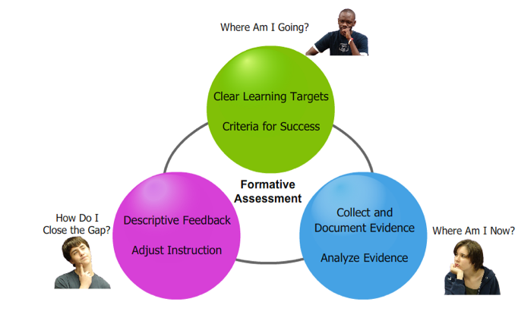

Slide 8
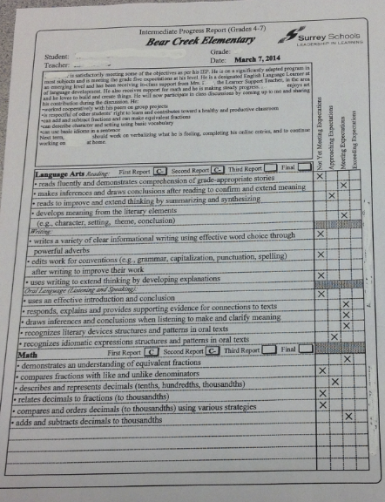
Before
This report card template does not allow for any descriptive feedback. The focus is solely on the letter grades.

Slide 9
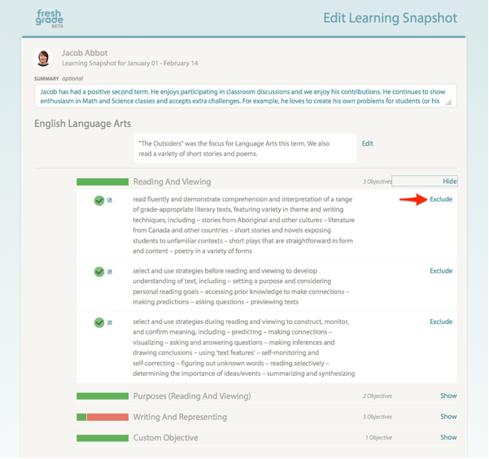
After
Fresh Grade is a tool which allows teachers to communicate with students and parents in a more effective manner.

